Slide 1
2D Vector Graphics for J2ME
March 20, 2007

Slide 2
What is Vector Graphics?
Vector graphics is the use of geometrical primitives such as points, lines, curves and polygons to represent 2D imagery.
Primitives based upon mathematical equations.
In contrast to the raster graphics, where the representation of images is a collection of pixels.

Slide 3
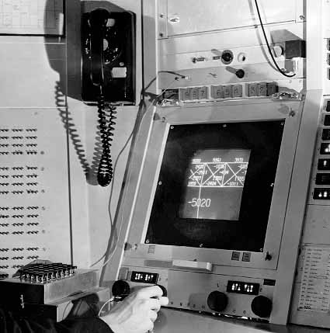
History of Vector Graphics
Vector graphics displays first originated in the 1950s.
An electron beam of the CRT display monitor was steered to trace out specific shapes using lines with the rest of the screen remaining black. As these shapes were being drawn, their coordinates were being logged in a “display file.” These vector-based monitors were also known as X-Y displays.
Allowed subpictures to be moved, rotated, etc. by modifying only a few lines in the display file.
First used by the US SAGE air defense system.
Used at the MIT Lincoln Laboratory by computer graphics pioneer Ivan Sutherland to run his program Sketchpad in 1963.
Also in the first few arcade games such as Space Wars and Asterioids.
Sketchpad
(Src: MIT Digital Archives)

Slide 4
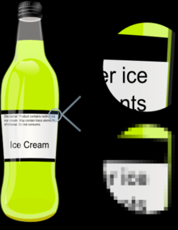
Vector vs. Raster
Vector
Made of mathematically defined primitives.
Resolution independent.
Smaller file size.
Infinite zooming in/out leads to no visual artifacts.
Manipulation such as scaling do not degrade the quality of the graphics.
Non-photorealistic.
Easily editable.
Raster
Made of pixels.
Resolution dependent.
Larger file size.
Any amount of zooming results in visual artifacts.
Manipulation such as scaling degrades image quality.
Photorealistic.
Need image editing tools.

Slide 5
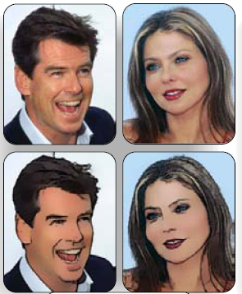
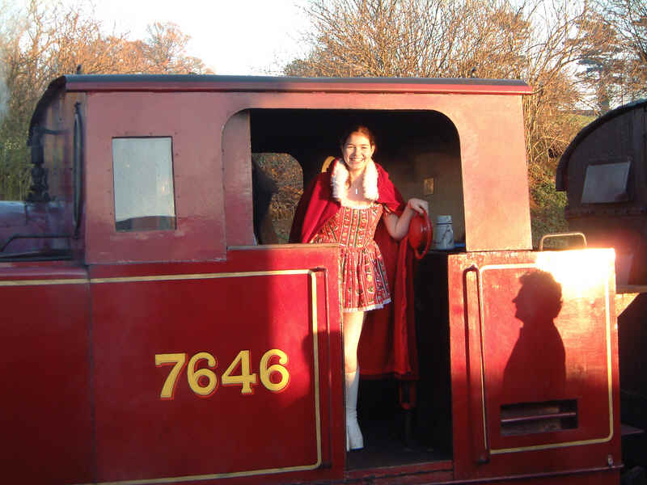
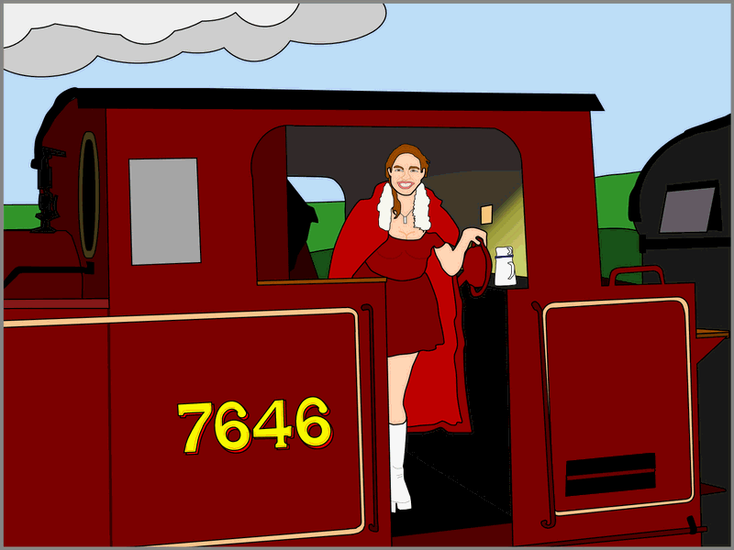
Raster -> Vector
Src: Holger Winnemoller et al. – Real-time Video Abstraction
Src: Wikipedia

Slide 6
Scalable Vector Graphics (SVG)
XML-based graphics standard from W3C.
Allows three types of visual entities:
  Graphics shapes
  Text
  Bitmap graphics like PNGs embedded
Defines a Document Object Model (DOM) to provide API’s for creating, deleting, modifying parts of the object model, thus the SVG content itself.

Slide 7
SVG Authoring Tools and Viewers
Inkscape
Sodipodi
Adobe SVG Viewer as a plugin to your browser. (IE 4.0 +, Firefox 4.5 +)

Slide 8
SVG Tiny (Mobile)
In 2003, the SVG Working Group introduced SVG Tiny, designed for mobile devices.
SVG Tiny 1.1 provides an open standard solution for delivering graphical content that works equally well on handsets and desktops.
SVG Tiny 1.2 introduces video, audio, gradients, stroke and fill opacity, styled text and scripting capabilities into mobile devices.
Produced with the help of industry leaders and invited experts in graphics, mobile computing and the web: Adobe, Canon, Ericsson, Expway, Groupe des Ecoles de Telecommunications, Ikivo, ILOG, Itedo, KDDI, Mercurial Communications, Nokia, Bitflash division of Open Text, Opera, Research In Motion, Sharp, Streamezzo, Sun Microsystems, ETH Zurich, Telecom Italia and Vectoreal.

Slide 9
SVG Tiny::Intro
SVG Tiny (SVGT) 1.1 is suitable for highly restricted mobile devices; Absence of scripting and styling, and no requirement to maintain a Document Object Model (DOM). Saves substantial amount of memory in most implementations.
In conjunction with the Java JSR 226 group, a lightweight interface called the microDOM, or uDOM, was developed. With this advance, lightweight programmatic control of SVG (for example, for games or user interfaces) and use with scripting languages, became feasible on the whole range of platforms from cellphones through to desktops.
This led to SVG Tiny 1.2 that is backwards compatible with SVG Tiny 1.1.

Slide 10
SVG Tiny 1.2::Structure
Optional XML Declaration. If present, must be first line of document.
<?xml version="1.0"?>
<svg xmlns="http://www.w3.org/2000/svg"
version="1.1" baseProfile="tiny"
viewBox="0 0 30 30">
<desc>Example SVG file</desc>
<rect x="0" y="10" width="30" height="10" fill="blue"/>
<text x="4" y="15" style="fill:#000000;stroke:none;font-family:Arial;font-size:3">Hello SVG World!</text>
</svg>
To specify that a given set of graphics stretch to fit a particular container element.

Slide 11
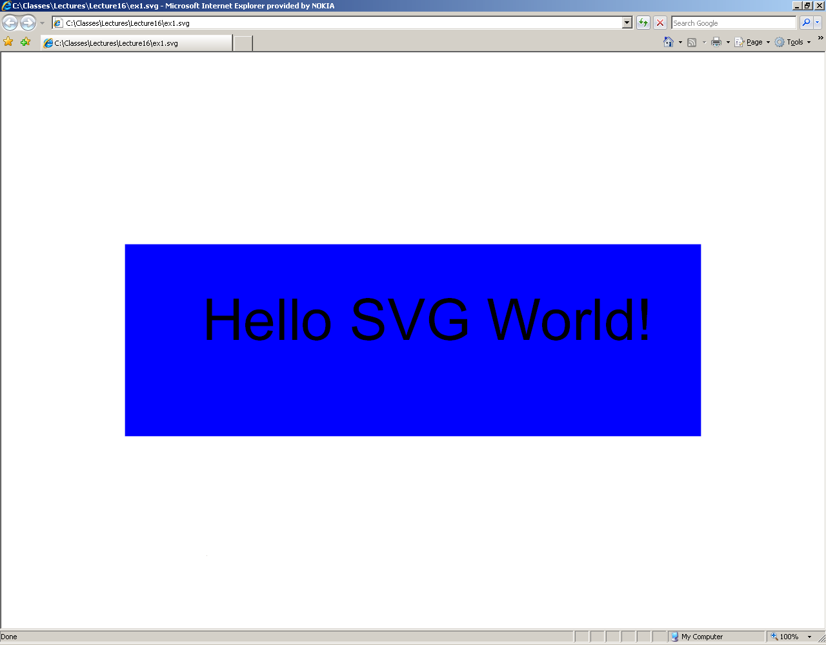

Slide 12
SVG Tiny::Rendering Model
Uses a "painters model" of rendering. ‘Paint’ is applied in successive operations. When the area overlaps a previously painted area the new paint partially or completely obscures the old. When the paint is not completely opaque the result on the output device is defined by the simple alpha compositing.

Slide 13
SVG Tiny::Rendering Model
Elements in an SVG document fragment have an implicit drawing order. Elements are rendered using a pre-order, depth-first walk of the SVG document fragment. Subsequent elements are painted on top of previously painted elements.

Slide 14
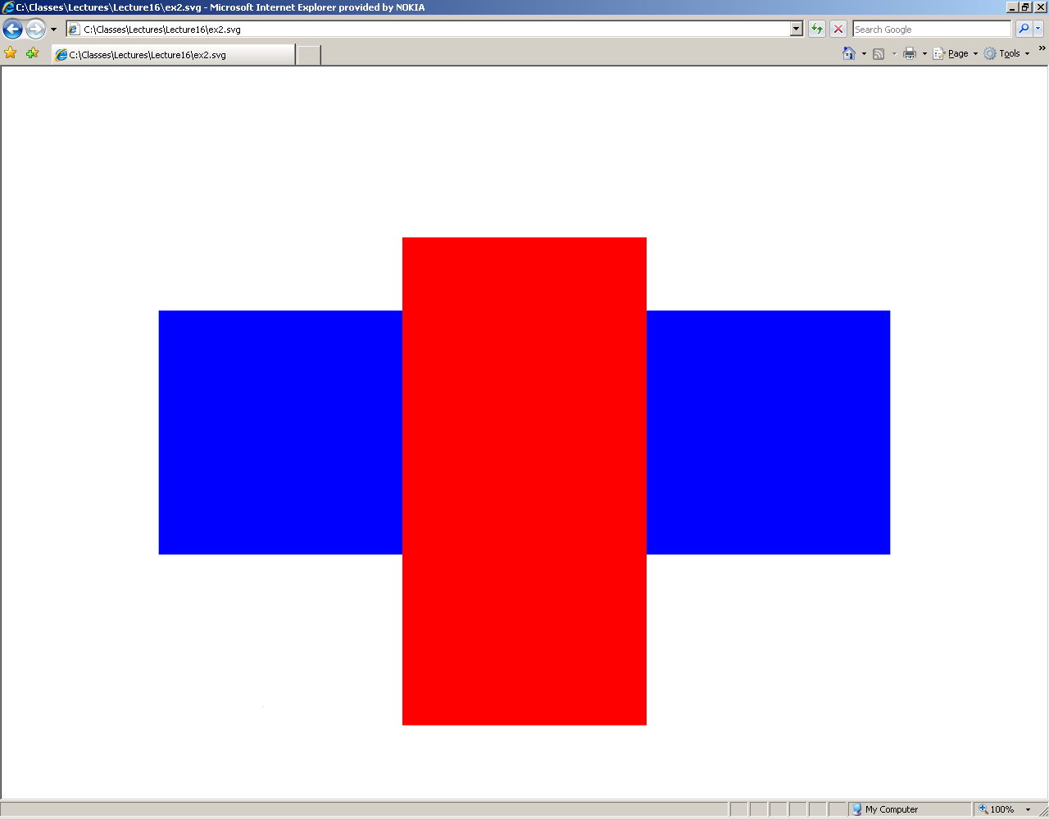
<?xml version="1.0"?>
<svg xmlns="http://www.w3.org/2000/svg"
version="1.2" baseProfile="tiny"
viewBox="0 0 30 30">
<desc>Example SVG file</desc>
<rect x="0" y="10" width="30" height="10" fill="blue"/>
<rect x="10" y="7" width="10" height="20" fill="red"/>
</svg>

Slide 15
SVG Tiny::Rendering Model
Shapes and text can be filled (i.e., apply paint to the interior of the shape) and stroked (i.e., apply paint along the outline of the shape).
Each fill and stroke operation has its own opacity settings; thus, you can fill and/or stroke a shape with a semi-transparently drawn solid color, with different opacity values for the fill and stroke operations.

Slide 16
SVG Tiny::Document Structure
Let’s look at:
http://www.w3.org/TR/SVGMobile12/struct.html

Slide 17
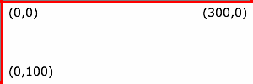
SVG Tiny::Coordinate System
The SVG Canvas is where all the SVG content is rendered.
The SVG Viewport is the viewing area where the user sees the SVG content.
The viewport coordinate system is also called viewport space and the user coordinate system is also called user space.
Initial user space is at the top/left of the viewport, with the positive x-axis pointing towards the right, the positive y-axis pointing down
A new user space can be created using transformations such as rotation, skewing, scaling and translation. (e.g. <g transform="translate(100,50)"> )

Slide 18
SVG Tiny::Basic Shape Commands
rectangles
circles
ellipses
lines
polylines
polygons

Slide 19
SVG Tiny::Basic Shape Commands
Rectangles
The 'rect' element defines a rectangle which is axis-aligned with the current user space. Rounded rectangles can be achieved by setting appropriate values for attributes ‘rx’ and ‘ry.’
Eg: <rect x="1" y="1" width="1198" height="398" fill="none" stroke="blue" stroke-width="2"/>

Slide 20
SVG Tiny::Basic Shape Commands
circles
The 'circle' element defines a circle based on a center point and a radius.
Eg: <circle cx="600" cy="200" r="100" fill="red" stroke="blue" stroke-width="10" />

Slide 21
SVG Tiny::Basic Shape Commands
ellipses
The 'ellipse' element defines an ellipse which is axis-aligned with the current user space based on a center point and two radii.
Eg: <ellipse transform="translate(900 200) rotate(-30)" rx="250" ry="100" fill="none" stroke="blue" stroke-width="20" />

Slide 22
SVG Tiny::Basic Shape Commands
lines
The 'line' element defines a line segment that starts at one point and ends at another.
Eg: <line x1=“550" y1="300" x2=“800" y2="100" stroke-width="5" />

Slide 23
SVG Tiny::Basic Shape Commands
polylines
The 'polyline' element defines a set of connected straight line segments. Typically defines open shapes.
Eg: <polyline fill="none" stroke="blue" stroke-width="10" points="50,375 150,375 150,325 250,325 250,375 350,375 350,250 450,250 450,375 550,375 550,175 650,175 650,375 750,375 750,100 850,100 850,375 950,375 950,25 1050,25 1050,375 1150,375" />

Slide 24
SVG Tiny::Basic Shape Commands
polygons
The 'polygon' element defines a closed shape consisting of a set of connected straight line segments.
Eg: <polygon fill="red" stroke="blue" stroke-width="10" points="350,75 379,161 469,161 397,215 423,301 350,250 277,301 303,215 231,161 321,161" />

Slide 25
In-Class Exercise
Substitute the rect primitive with each of the others in your svg file.
Modify some of the values and see how the rendering is affected.

Slide 26
JSR 226
Standard for interactive and animated 2D graphics on the J2ME platform.
Developed within the Java Community Process (JCP), acknowledging the mobile industry standardization of SVG Tiny and built its APIs on top of SVG Tiny.
Offers simple methods to load and display SVG Tiny files on-the-go, as well as manipulate SVG Tiny content or simply create SVG Tiny content from scratch on the device, for instance for data-driven graphics.
Works for SVG Tiny 1.1.
JSR 287 is designated to support SVG Tiny 1.2.
The JSR 226 specification version 1.0 is now finalized.
Devices supporting JSR 226 can be found here.

Slide 27
JSR 226::Overview
JSR 226 brings rendering and playback of vector-based 2D graphics to Java-powered mobile applications.
Headed by Nokia, JSR 226 comprises the major players in the mobile industry.

Slide 28
JSR 226 API
A primary objective of JSR 226 is to define the Mobile 2D Graphics (M2G) API that align closely with the capabilities of the SVG-Tiny format.
Focused mainly on the playback and runtime manipulation of SVG content.
Consists of high-level classes for creating and rendering vector images and low-level classes for manipulating the XML components of a vector image as parts of a Document Object Model (DOM) tree.
Vector images are instances of ScalableImage obtained from the static createImage() method of that class. You use an instance of ScalableGraphics to draw ScalableImages onto a MIDP Graphics context. SVGImage is a subclass of ScalableImage that provides hooks for event handling and access to the underlying DOM document.
API provides the SVGAnimator class that creates and controls a Canvas object to automatically handle screen updates in response to animation events and programmatic modifications to the image.
Classes defined in the javax.microedition.m2g and org.w3c.dom.svg packages.

Slide 29
javax.microedition.m2g
ScalableGraphics This is the fundamental class for 2D rendering.
SVGAnimator This class handles automatic rendering of updates and animations in an
SVGImage to a target user interface component.
SVGEventListener This interface is used to forward platform-specific events to an
application.
SVGImageThis class represents an SVG image conforming to the W3C SVG Tiny 1.1 Profile.
ExternalResourceHandler This interface is used to load synchronously any external resources needed for loading SVG content.
org.w3c.dom.svg
SVGAnimationElement This interface represents an animation element, and includes methods to control the timing of animations.
SVGElement This interface represents an SVG element in the document tree.
SVGLocatableElement This interface represents a drawable SVG element, typically a shape, image, or text.
SVGMatrix This interface represents an "SVG matrix" data type, identified by an affine transformation â€“ equivalent to a linear transformation followed by a translation.
SVGPath This interface represents an "SVG path" data type used to define the path geometry.
SVGPoint This interface represents an "SVG point" datatype, identified by its x and y components.
SVGRect This interface represents an "SVG rectangle" datatype, consisting of a minimum X, minimum Y, width, and height values.
SVGRGBColor This interface represents an "SVG RGB color" data type, composed of red, green, and blue components.
SVGSVGElement This interface represents an element in an SVG document tree.

Slide 30
Actually Running M2G Midlets
Download the RI from Forum Nokia.
Emulator is \midp\bin\midp.exe
Run the three sample MIDlet examples.

Slide 31
References
SVG Books
SVG Tiny Specification
JSR 226 API Documentation and Reference Implementation

Slide 32
Class Projects

